Slide 1

PROJECT GREEN ENGINE

Slide 2
TEAM NAME
GREEN ENGINEERS

Slide 3

Problem Statement
Reduce, Reuse, Recycle are the key concepts that can be used to protect our environment. Sustainable way to reuse/recycle used household materials is the need of the hour.
We have local arrangements to collect used household materials. But sometimes we have restrictions on how frequently collection drives happen or materials that will be collected. It does not have a reward mechanism for the reusable/recyclable materials that we provide. Giving materials to ragpickers does not seem to be a reliable option either.
In order to attract larger population towards sustainable solution, a well-organized channel of disposing materials is important. There is also a need to improve the reuse of unused materials (clothes, utensils, books, toys, etc.).

Slide 4
Solution summary
An online website is developed to facilitate collection and reuse/recycle of used household materials through an authorized channel.
Users can schedule pick-up, Agencies will collect and do the needful in sustainable ways ( Recycle , Reuse).
Based on products collected users will be rewarded/paid.

Slide 5
Rewarding mechanism
Provision to choose pick-up date and time
Reselling of reusable items
Secure collection through authorized channel
Organized channel for recyclable/reusable products management
KEY FEATURES

Slide 6
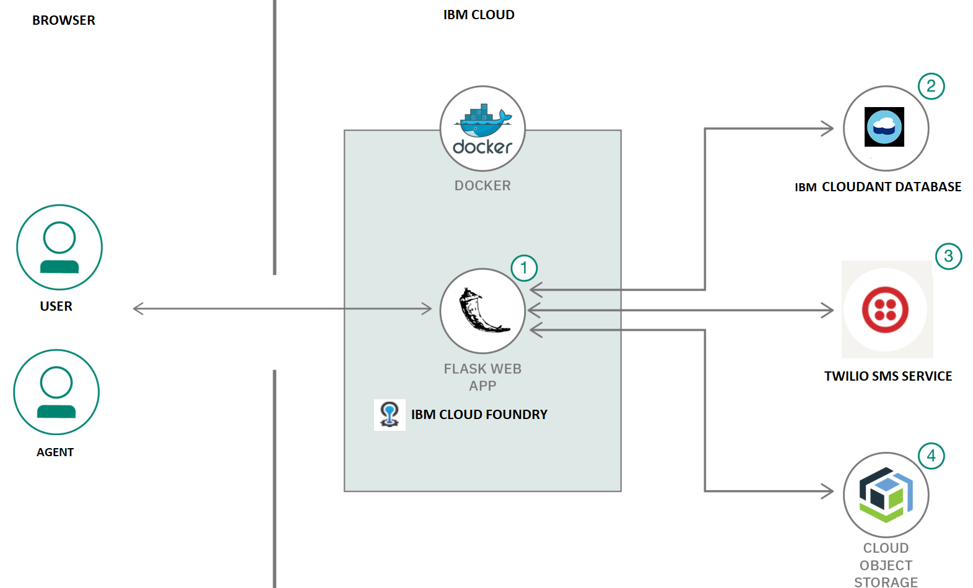
Architecture

Slide 7
FUTURE ENHANCEMENTS
Introducing Mobile App
Better rewarding schemes
More user engagement using ML
Establishing a channel with local shop, online website, etc. and cover more areas
DIY Learning videos

Slide 8
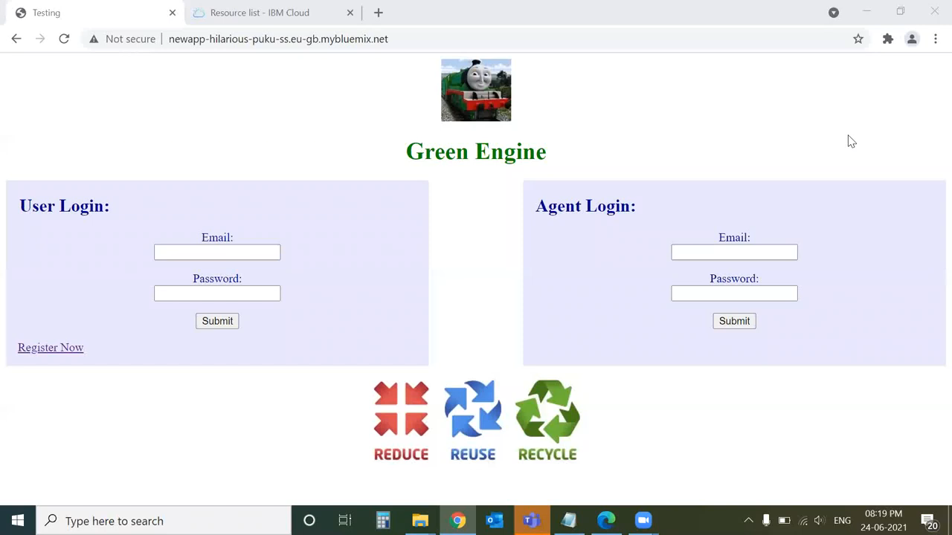
Demo video

Slide 9
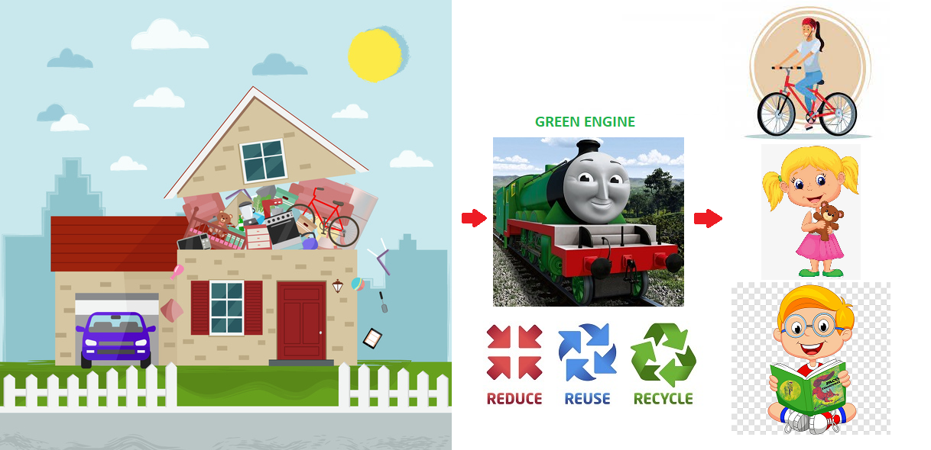
PICTURE REPRESENTING OUR PROBLEM

Slide 10
TEAM MEMBERS
Rashmi Bhat
Rashmi_Bhat2@Dell.com
Julian Jossen
Julian_Jossen@Dell.com
Namrata Suliya
Namrata_Suliya@Dell.com
Bhavitha Koduru
Bhavitha_Koduru@Dell.com
Hiren Pitroda
Hiren_Pitroda@Dell.com

Slide 11
QUESTIONS

Slide 12
BACKUP : ADDITIONAL DETAILS

Slide 13
Flow-chart
Show pickup history and rewards earned
User login
Agent login
Send confirmation message to User and pickup message to Agent
Update User’s Order Summary with quantity and reward points
Book a slot
Weigh and enter the details
Logout
Logout

